Slide 1
Introduction to variant analysis
Dr. Dennis Wang
Adapted from Lucy Crooks’ 2016 lecture

Slide 2
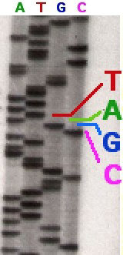
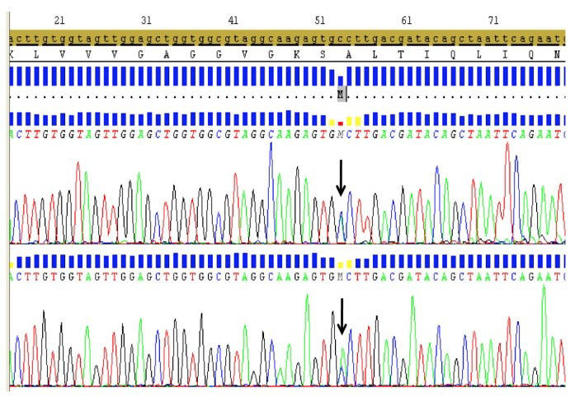
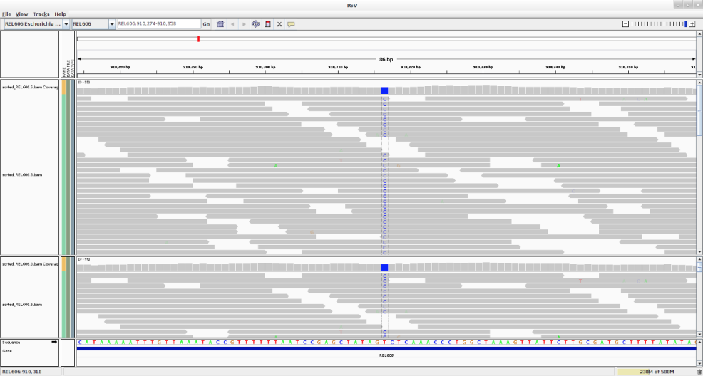
What are variants and How are they identified?
DNA Variants
Human DNA has approx. 6,000,000,000
All humans are are 99.9% identical at the base level
6 million bases can be different between normal healthy individuals
Plus thousands of bases that can be different between cells of an individual
Omics techniques to identify mutations
Digestion/gel separation
Sanger sequencing
Targeted sequencing (NGS)
Whole exome sequencing (NGS)
Whole genome sequencing (NGS)
RNA-sequencing (NGS)
ChIP-sequencing (NGS)

Slide 3
How do we get from reads to identifying the genetic change that has caused a patient’s disease?
Variant analysis!

Slide 4
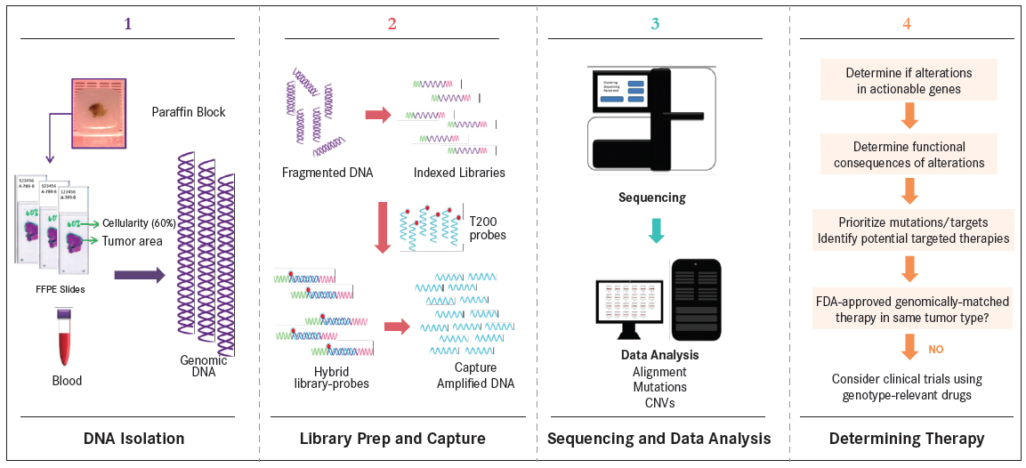
Clinical NGS Pipeline
Adapted from Chen et al. Clin Chem. 2015
Samples also include fresh frozen tissue and lymph biopsies
Targeted sequencing panels are more often used in the clinic

Slide 5
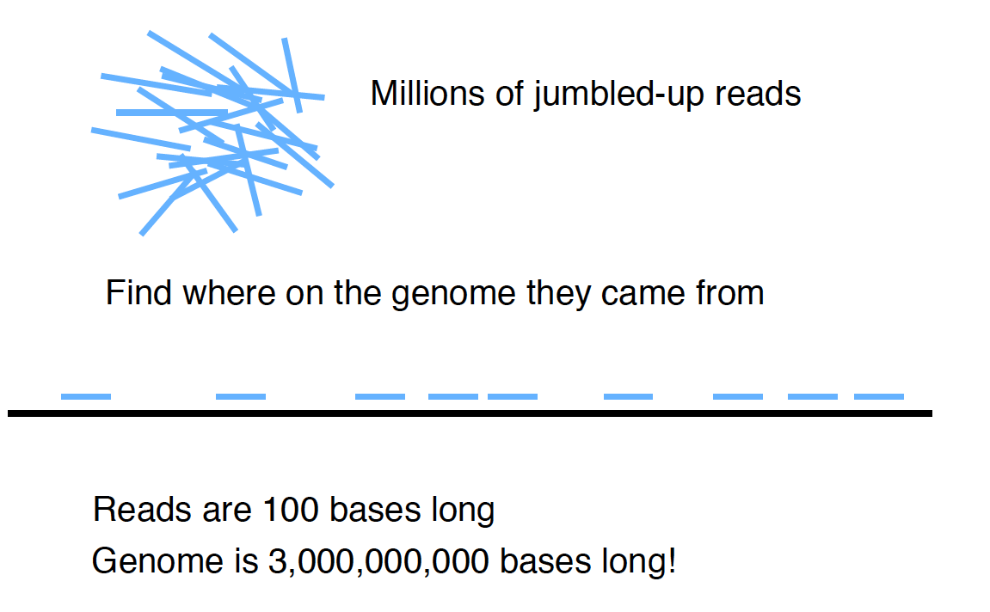
1. Alignment

Slide 6
We use a reference
Aligning to a reference is much easier than de novo genome assembly
The original human genome reference was completed in 2003, taking 13 years
It is a mixture from several individuals
It is not a consensus!

Slide 7
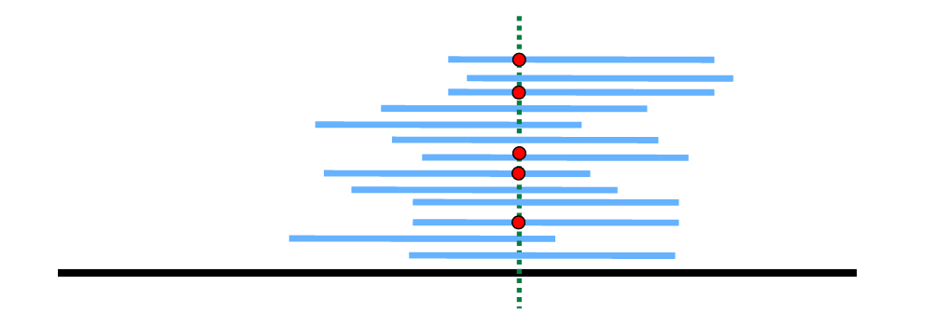
2. Variant calling
Look for differences from the reference (and normal sample) at each position
Depth/coverage = how many reads are aligned over the position
Are there a significant number of reads?

Slide 8
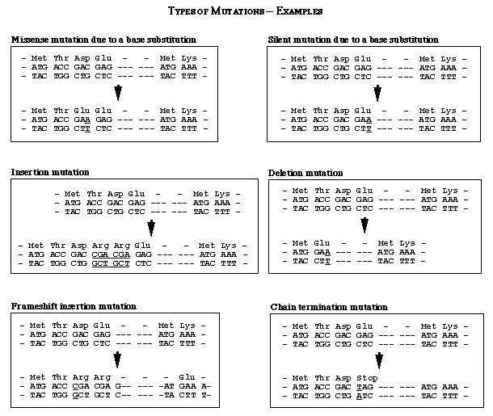

Slide 9
3. Quality assessment
Many quality scores are generated that can be used to filter reads or variants
Unclear which are most useful and how they relate to each other
Best is to have a “truth set” or “gold-standard” to filtering strategies
Have to strike a balance between missing true variants (sensitivity) against calling a variant by mistake (precision)

Slide 10
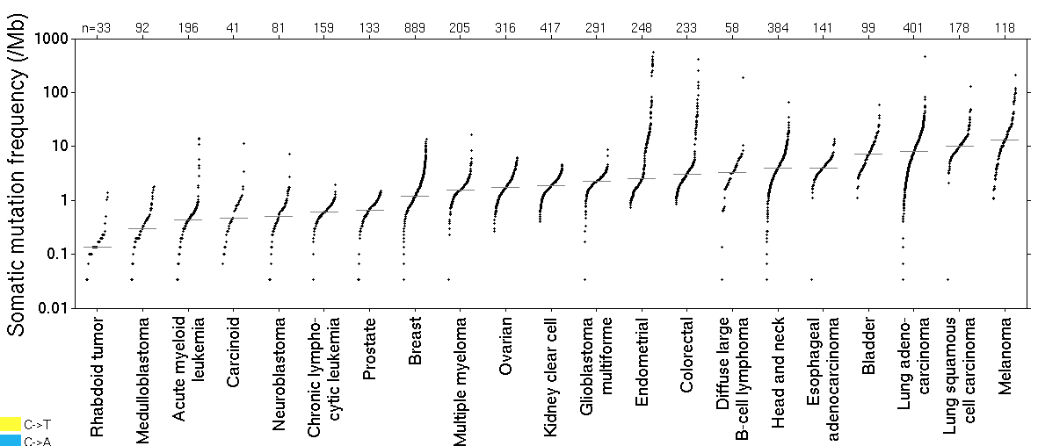
4. Identify key variants
Diagnostics
Small set of variants connected to specific disease
Research
Large set of variants describing the biological pathway or mechanism to disease

Slide 11
4. Identify key variants
1. What is the type of disease?
2. What type of mutation is present?
3. Where is the mutation found?
4. Is the mutation expressed?
5. How frequent is it?
6. What does it do?

Slide 12
4. Identify key variants
Aspects of this process are referred to as:
Variant annotation
Get more information
Variant interpretation
Integrate the information
Variant prioritisation
Link to to clinical and functional information

Slide 13
Challenges
Sequencing generates some dirty data
GC rich regions are problematic
Lots of data and many steps (algorithmic)
Need bioinformatics skills
Need reproducibility
Subjective
Be quantitative
There are best practices!
Can be expensive
High requirements for computer processing and storage
Data from 1 HiSeq run equivalent to 48 HD movies
Need to connect the right people

Slide 14

Use the Cloud
We will use Google Drive, Classroom, Embassy, Galaxy, etc.

